Slide 1
Project Title: Automated Art Generation
Group member (1) ALOK RAJ GUPTA 1503210024
Group member (2) ABHAY PRATAP SINGH 1503210001
Group member (3) KAPIL VERMA 1503221028
Project Guide: Prof. Hari OmUpadhyay

Slide 2
Problem Introduction:
In fine art, especially painting, humans have mastered the skill to create unique visual experiences.
But far the algorithmic basis of this process is unknown and there exists no artificial system with similar capabilities.

Slide 3
Motivation :
We want to create an artificial system based on a Deep Neural Network that creates artistic images of high perceptual quality.
The system uses neural representations to separate and recombine content and style of arbitrary images, providing a neural algorithm for the creation of artistic images.

Slide 4
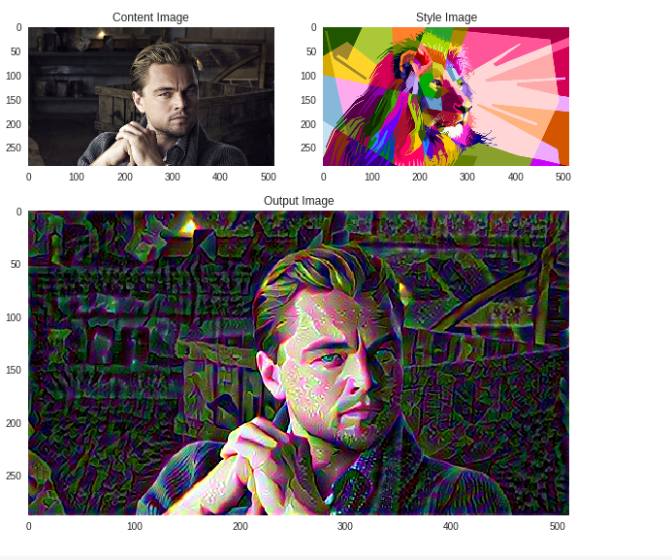
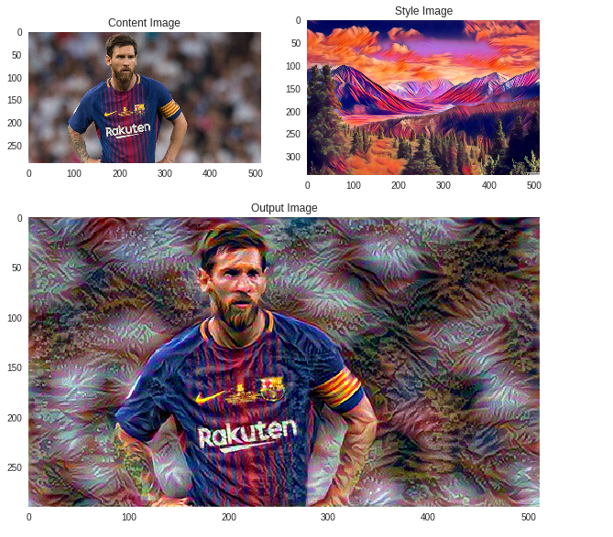
Here is a Example :

Slide 5
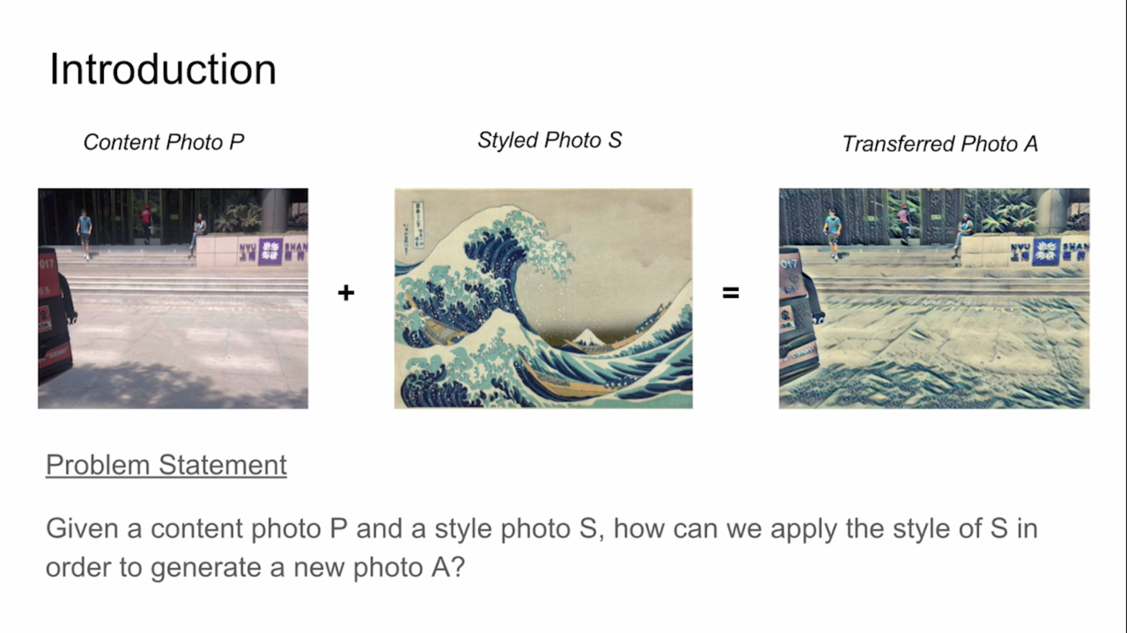
Proposed Method :

Slide 6
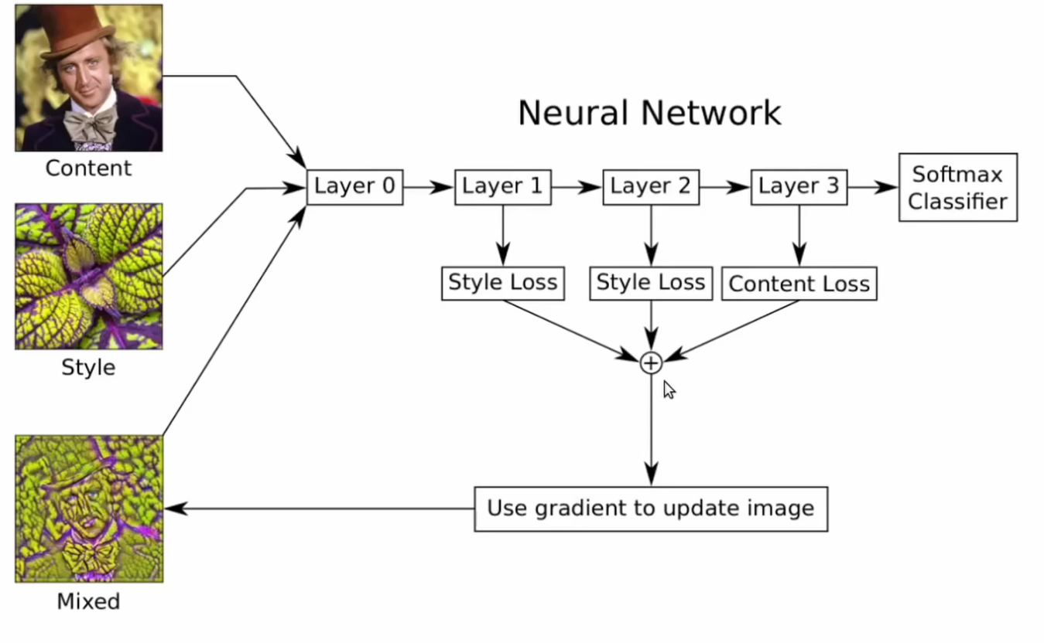

Slide 7
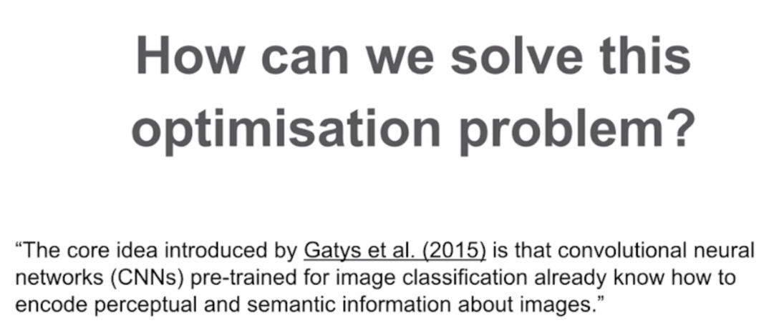
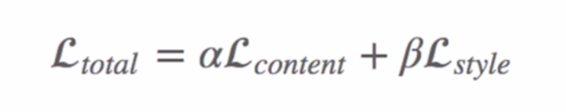

Slide 8
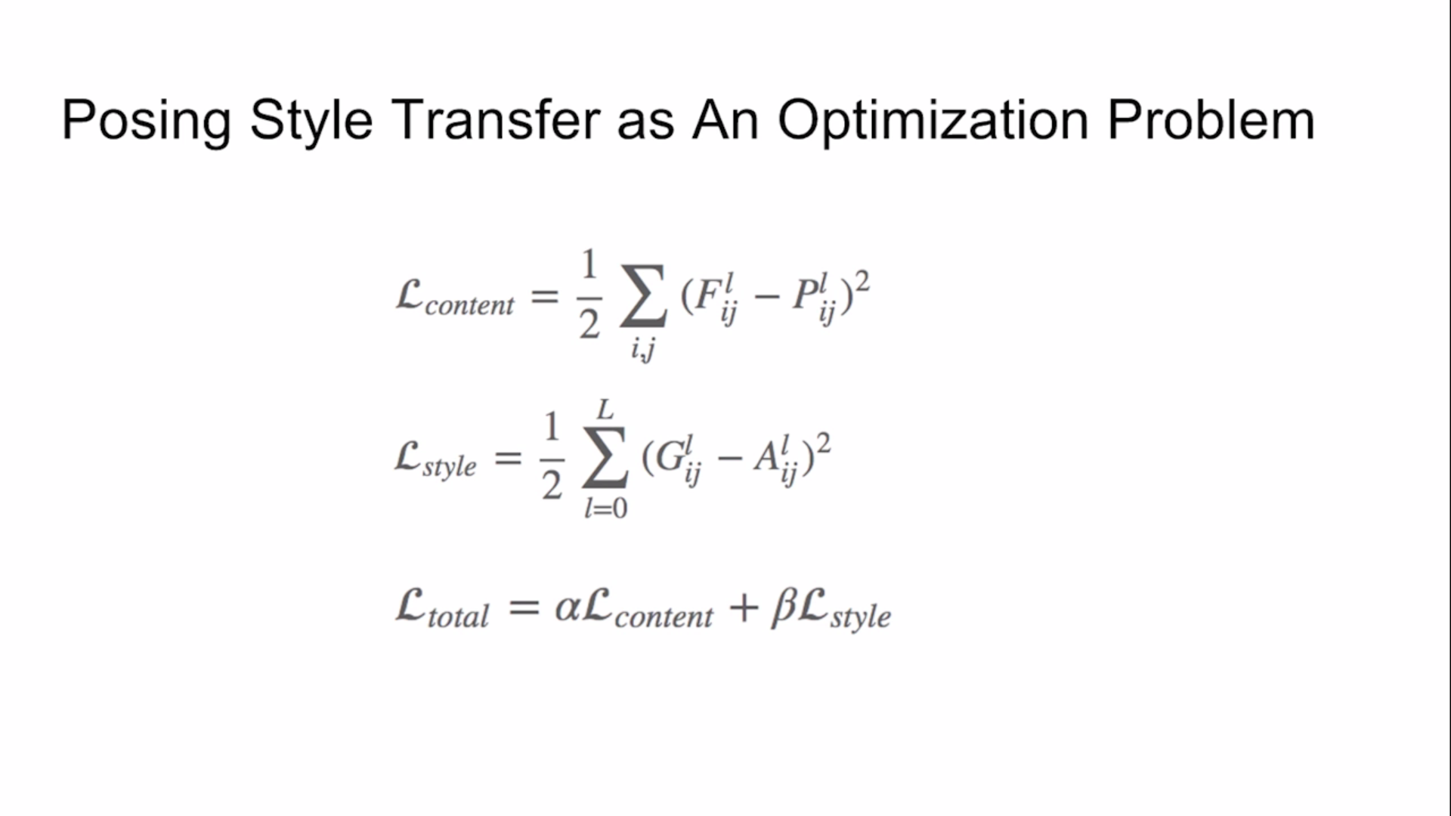

Slide 9
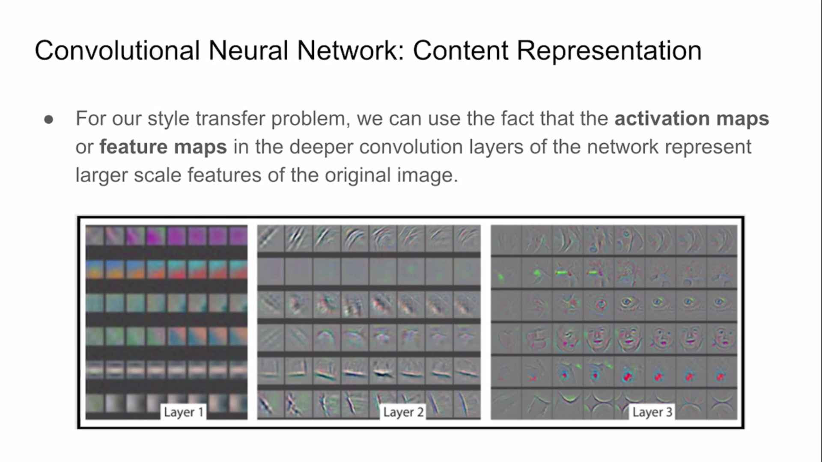

Slide 10
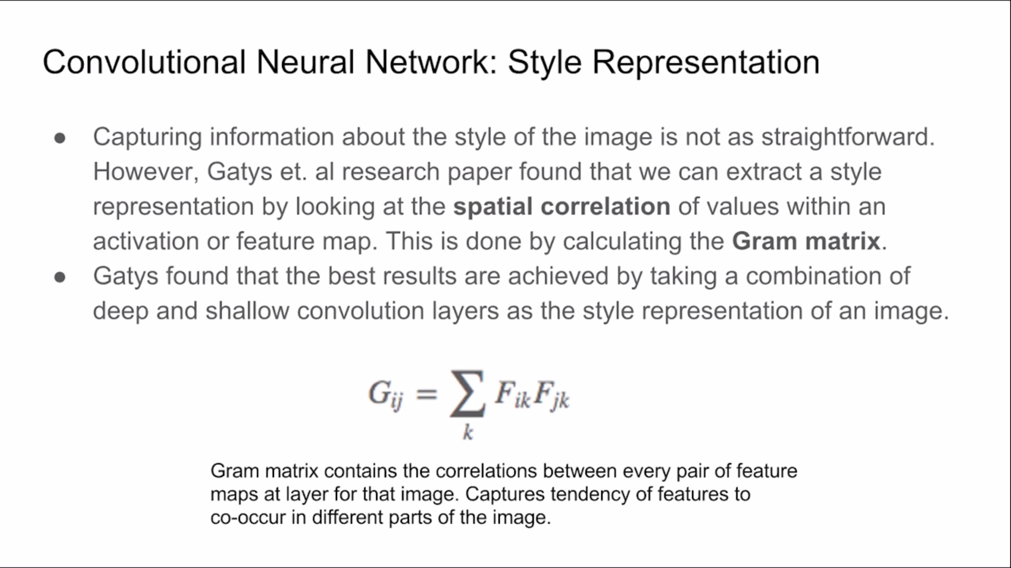

Slide 11
Software and Hardware requirements :
● Programming Languag: Python 3.0
● Frameworks: Tensorflow , Keras
● Plateform: Google Colab
GPU: 1xTesla K80 , compute 3.7, having 2496 CUDA cores , 12GB GDDR5 VRAM
CPU: 1xsingle core hyper threaded Xeon Processors @2.3Ghz i.e(1 core, 2 threads)
RAM: ~12.6 GB Available
Disk: ~33 GB Available

Slide 12
Related Previous work :
In the August of 2015, a paper came out titled ‘A Neural Algorithm of Artistic Style’ by Leon A.
Gatys, Alexander S. Ecker, and Matthias Bethge. And also few more papers published to
increase the scope of the above paper.
● Artistic style transfer for videos by Manuel Ruder, Alexey Dosovitskiy, Thomas Brox.
● Preserving Color in Neural Artistic Style Transfer by Leon A. Gatys, Matthias Bethge,
Aaron Hertzmann, Eli Shechtman.

Slide 13
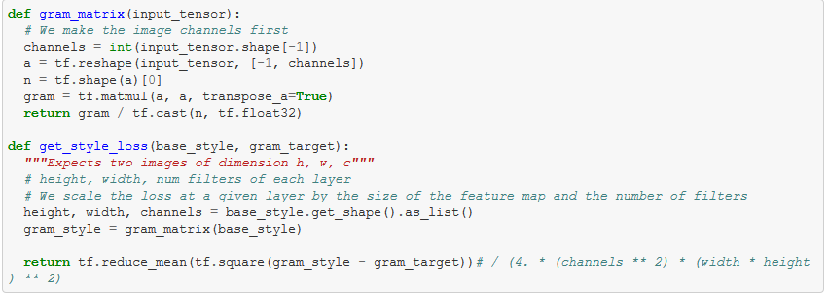
Implemention Details
Content Loss:
Style Loss:

Slide 14
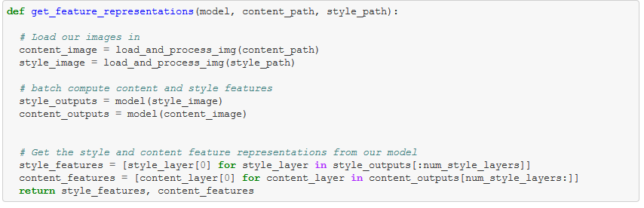
Apply style transfer :

Slide 15
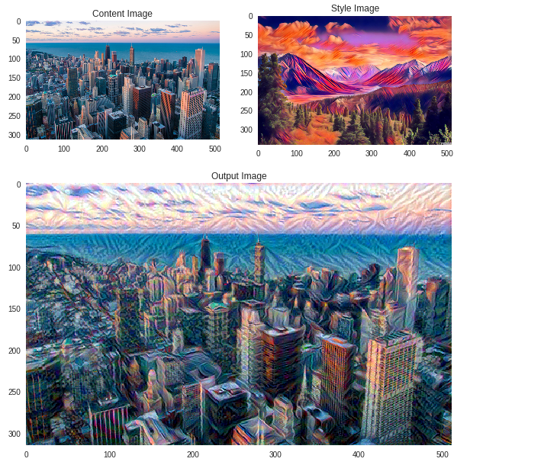
Results:

Slide 16
References:
● A photograph of the Tubingen in Germany in a variety of styles.
● Image Style Transfer Using Convolutional Neural Networks by Leon A. Gatys, Alexander S. Ecker, Matthias Bethge.
● Artistic style transfer for videos by Manuel Ruder, Alexey Dosovitskiy, Thomas Brox
● Preserving Color in Neural Artistic Style Transfer by Leon A. Gatys, Matthias Bethge, Aaron Hertzmann, Eli Shechtman
● The Stanford course on Convolutional Neural Networks (Stanford CS231n course)
● TensorFlow Website: MNIST digit classification tutorial for beginners and for experts, Deep CNNs, playground
● Keras as a simplified interface to TensorFlow.

